Slide 1

Thermal-RGB Analysis Hub títulos
Enhancing and Registering Multimodal Images for Computer Vision
Ing. Paula Alejandra Ortiz Santana
Instituto Tecnológico Metropolitano
2024

Slide 2

Motivation and Objectives
Motivation
Objectives
Combine thermal and RGB imaging
Enhance analysis and visualization
Applications: monitoring, data fusion
Develop image registration methods
Improve thermal-RGB image fusion
Enable seamless multimodal visualization

Slide 3
Methodology
Image Preprocessing
Feature Extraction
Statistical Analysis
Fusion Approach
Load thermal and RGB images
Apply Gaussian filtering for noise reduction
Calculate mean and variance per image
Normalize features for uniform analysis
Scatter plots for feature comparison
Boxplots and histograms by class
Combine thermal and RGB images
Use weighted blending for enhanced visuals

Slide 4
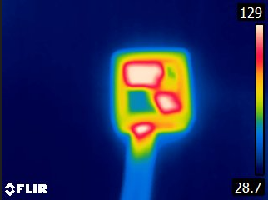
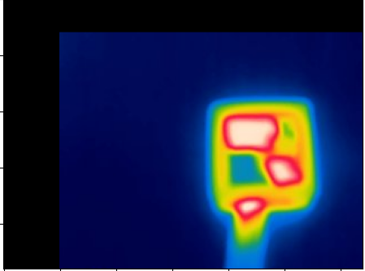
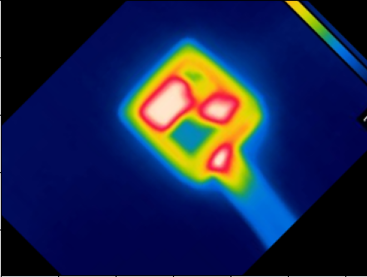
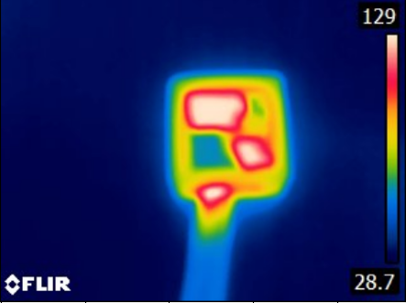
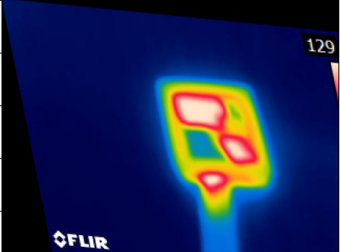
Results
Geometric Transformations
Translation
Rotation
Scaling
Deformation

Slide 5
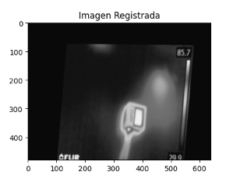
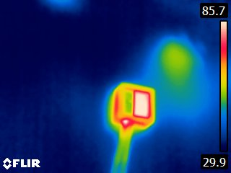
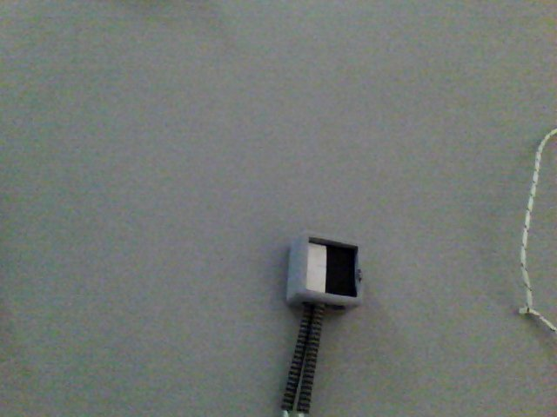
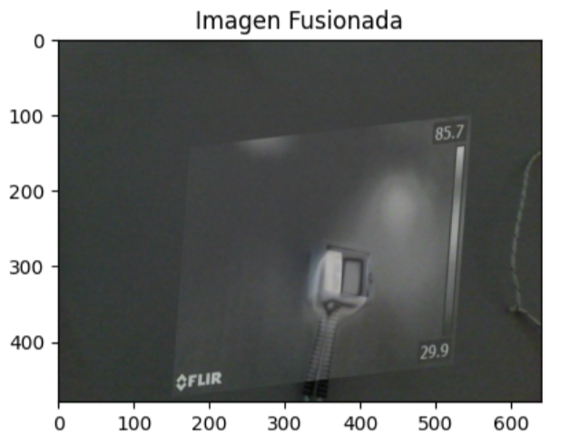
Results

Slide 6
Results
Thermal and RGB images show distinct statistical properties.
Thermal images exhibit higher mean values, indicating temperature sensitivity.
RGB images have lower mean values, consistent with the visible spectrum.
Variance in thermal images is lower than in RGB images.
Fusion through SimpleITK registration enhanced alignment accuracy.

Slide 7
Future Work
Conclusions
Explore machine learning techniques for feature extraction.
Implement shifting strategies to improve fusion results.
Test advanced algorithms for better registration accuracy.
Thermal and RGB images offer complementary information.
Image registration with SimpleITK provided precise alignment.
Fusion techniques enhanced interpretability of combined features.

Slide 8


¡MUCHAS GRACIAS!

